Slide 1
CanOpener 2024
PRESENTED BY:
PRESENTED BY:
Notes:
Howdy, I am Christopher Mount and I would like to welcome you to our CAN Opener. This is a CAN call for teams, sponsors, and volunteers to participate in this year’s event. I would like to give a special thanks to our Signature Dish Sponsor, Canon.

Slide 2
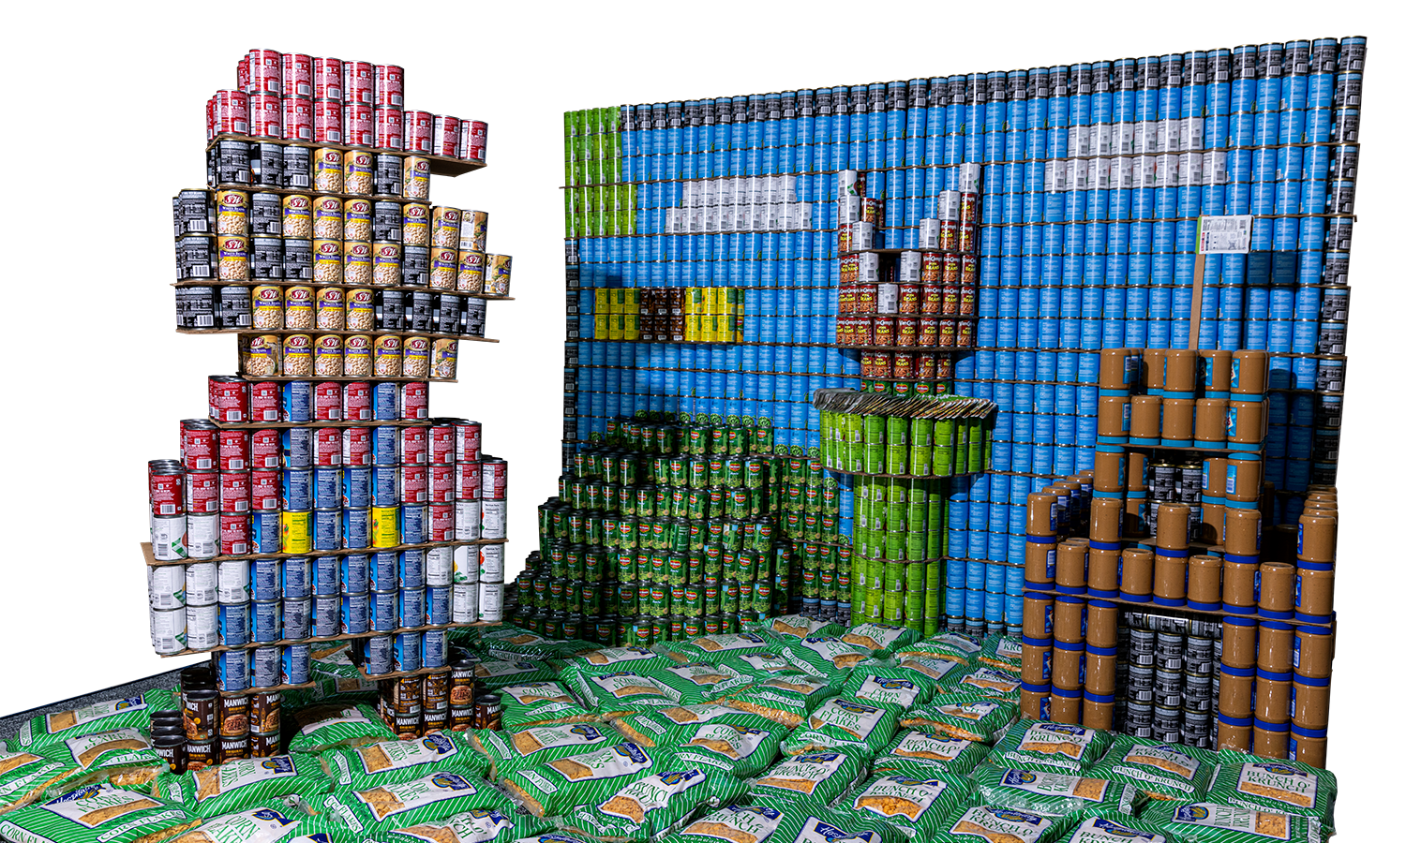
agenda
What is Canstruction?
It’s About the Cans!
Budget & Fundraising
Event Rules
Timeline
Oregon Food Bank

Slide 3
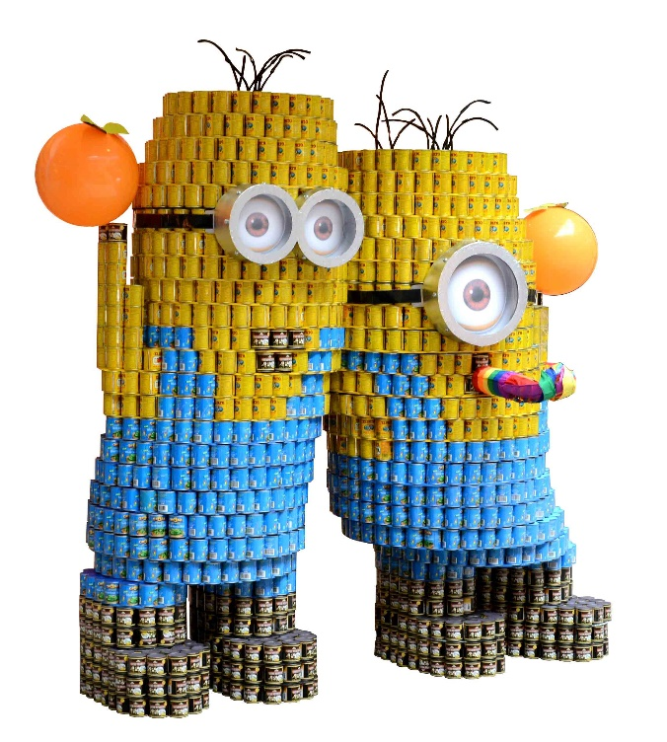
What is Canstruction?
A fun and unique design-build competition for architects, engineers, and construction professionals which helps fight hunger in our local community.
Awareness
Networking
Notes:
Canstruction Portland showcases an amazing event which allows our community of contractors, engineers, and architects to use their talents to build larger than life structures out of food. These structures are put on display at Pioneer Place to raise awareness of the hunger issue our community faces.

Slide 4
How to participate?
Sponsor
Volunteer
Create a Team
Notes:
There are three ways you or your company can participate in this year’s event. You can become a sponsor for the event, a volunteer, or create a team.

Slide 5
It’s about the cans!
Make your statement and go for an Award
Best Original Design
Best Meal
Best Use of Labels
Structural Ingenuity
Most Cans
People’s Choice
Notes:
Best original design encompasses all the categories (top award). In 2019, Canstruction Portland placed third internationally. We have had two first place in previous years; looking for our next big winner!
Best meal – food values, good sources of nutrition; can you create a meal from this structure?
Best use of labels
Structural ingenuity – how did they get this to stand? How did they do that?
Most cans
People’s Choice – voting in person at the mall, online on Facebook. Recognizable; think pop culture.

Slide 6
Budgeting and fundraising
You are required to purchase the cans for your structure.
Create your design
Typical structures cost between $3,000 - $6,000
Make a budget
Extra Cans
Leveling Courses
Props
Tape
Get the funds
Ask your company
Fundraising events
Contact your Vendors

Slide 7
Need Help??
New this year?
Having a structural issue?
Need a Mission Statement?
Are you stuck?
Email us at teams@canstructionpdx.org to let us mentor your team

Slide 8
Event Rules
Bring on the CANS

Slide 9
Food, food, and more food
Allowed
Not allowed
Aluminum cans of all sizes
Full, unopened, cans
labels intact and legible
Plastic containers
(non-weight bearing only)
Boxes and bags of food
(not encouraged)
Glass containers
Plastic containers (weight bearing)
Food items with their labels covered, stripped off, or altered
Empty containers
Open or exposed food items
Pet food
Alcoholic beverages
Soda or junk food
Perishable or homemade items

Slide 10
Building Materials to go big
Approved to be in structure
Not approved to be in structure after completion
¼ inch and thinner cardboard, foam-core, masonite, MDF, plywood, and plexiglass.
¼ inch and thinner cardboard tubes, wooden and threaded rods used for alignment.
Velcro, magnets
Clear single and double-faced tape
High-tension rubber bands, nylon string, wire, tie-backs, zip ties
2 x 4 boards
Half-inch or thicker plywood
Half-inch or thicker tubing
Sheet metal
Permanent adhesive
Hot glue
No power tools

Slide 11
Build-out Regulations
Maximum size for structure is 10ft x 10ft x 8ft tall.
Five members of the team are allowed on the carpet at one time; other team members are allowed to assist on site.
You are allowed approximately 6 hours of build time to complete your structure.
Bring all supplies you will need to build your structures.
Leave your area “broom clean”

Slide 12
timeline
Submittals
Pre-build
Schedule
Gala and Awards
DeCanstruction

Slide 13
submittals
Deadline for Entry: Friday, May 24, 2024
Submittal No. 1: Friday, June 21, 2024
Submittal No. 2: Friday, July 19, 2024
Submittal No. 3: Friday, August 23, 2024
CanstructionPDX website will have all submittal details and forms:
www.canstructionpdx.org

Slide 14
prebuild
Confirm supply
change of label, enough at one store…order in advance!
Prepare building materials
pre-cut leveling devices (foam core, plexiglass, cardboard)
Recommend minimum partial pre-build
Complete 3-4 weeks before build-out.

Slide 15
Event schedule
Food Transport: OFB will pick up the food 1-2 weeks before the event at one place. (Mid-Sept date to be determined)
Build Out: Monday
Judging: Tuesday (afternoon)
Awards Gala: Tuesday (evening)
Public Viewing: Monday - Sunday
De-canstruction: Sunday (evening)

Slide 16
Build-Out
Five team members
Supplies
leveling devices
ladder
clear tape (leave on can)
box cutter
Take out what you brought in
Eat in designated eating areas
No power tools

Slide 17
Gala and awards
Jury members will tour the structures and deliberate the day of the Gala
Teams, sponsors, and volunteers are recognized at the Gala
Date and location to be announced

Slide 18
Decanstruction
Each team must bring at least 5 volunteers
OFB bins and original boxes will be available for you to reload your food
All items that teams brought into Pioneer Place must be removed
We have limit disposal resources
Teams are responsible for leaving their site “broom-clean”

Slide 19
Questions
canstructionpdx.org
@canstructionpdx

