Slide 1
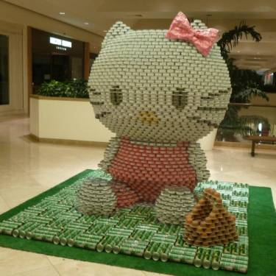
CANstruction Guide

Slide 2
Outline
What is Canstruction? (Slide 3)
It’s About the Cans! (Slide 6)
Budget & Fundraising (Slide 16)
Event Rules (Slide 29)
Logistics (Slide 37)
Oregon Food Bank (Slide 48)

Slide 3
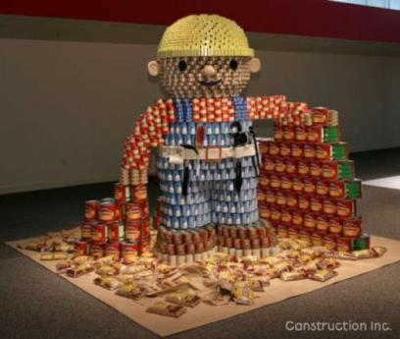
What is Canstruction?
A fun and unique design-build competition for architects, engineers, and construction professionals.

Slide 4
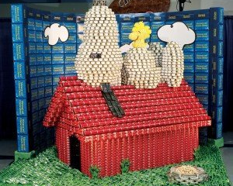
Why Participate?
Help fight the growing hunger problem in our area
To give young professionals hands on experience in design
Company team building, networking and firm exposure

Slide 5
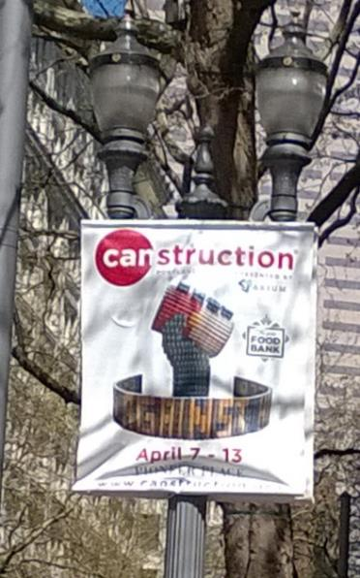
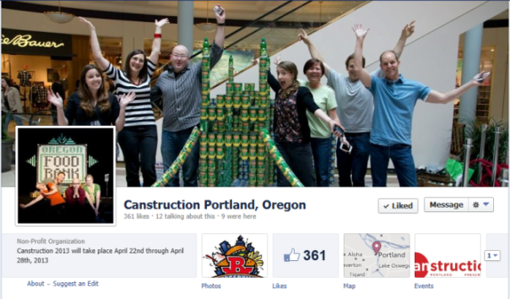
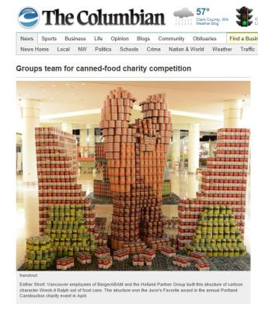
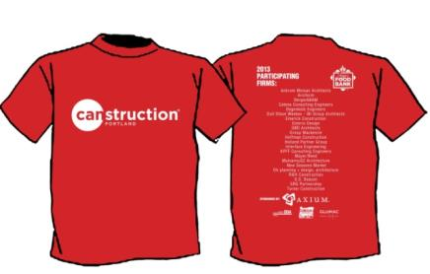
Media Exposure
Notes:
Professionals within the design/build industry experience positive public relations with media coverage from TV, radio, newspapers, and magazines. A/E/C professionals are spotlighted giving back to the communities they help build.
Featured in local media such as:
Daily Journal of Commerce
Oregonian, Columbian
News Channels 2, 6, 8 and 12
Portland Tribune
Radio: KUPL, KBOO & KPAM
Nationally
People
Home and Garden magazine
Good Morning America

Slide 6
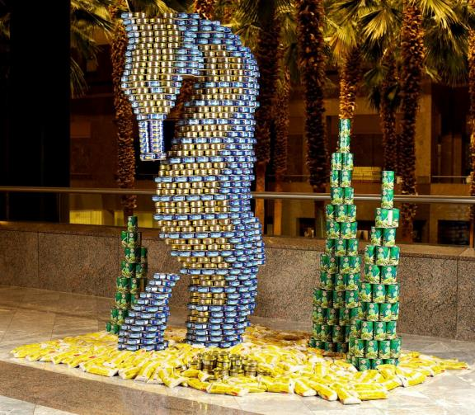
Its About the CANS!
PORTLAND

Slide 7
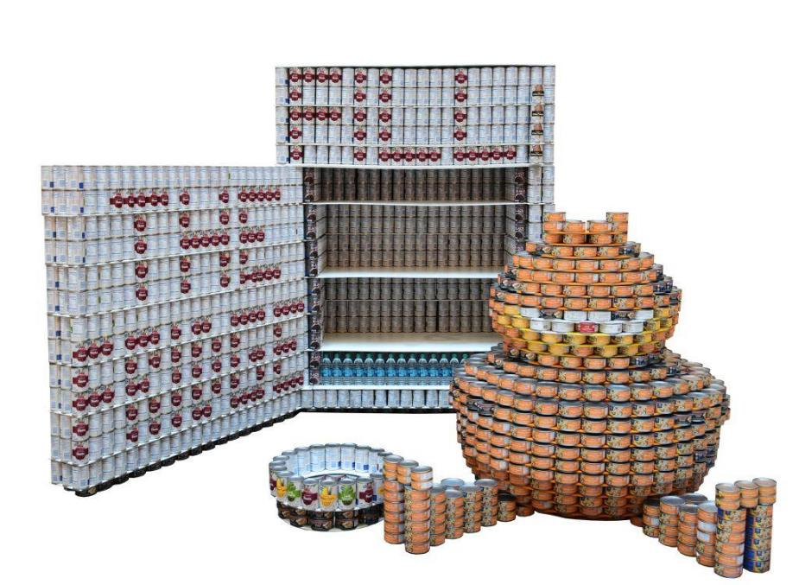
Choosing a Structure: Who is your audience & what is your message?
Illuminating the hunger issue?
Are you engaging all sectors of the public?
Displaying good design?
Creating a visual and talking point?

Slide 8
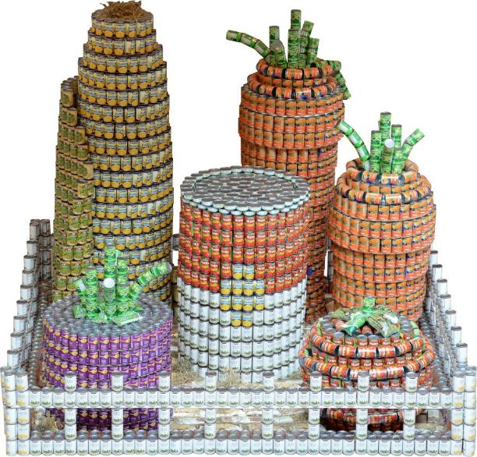
Message: Mission Statement & Structure should speak to one another
The Design Community cares about people in need.
The need for food in Oregon is Growing. We can do our part in a creative way to inspire others to get involved & participate.

Slide 9
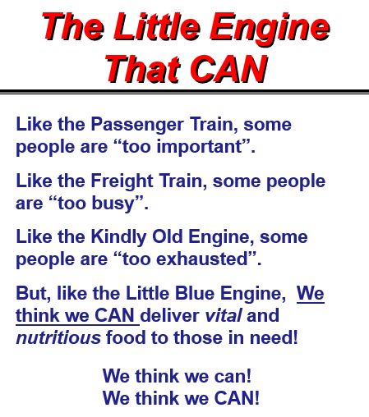
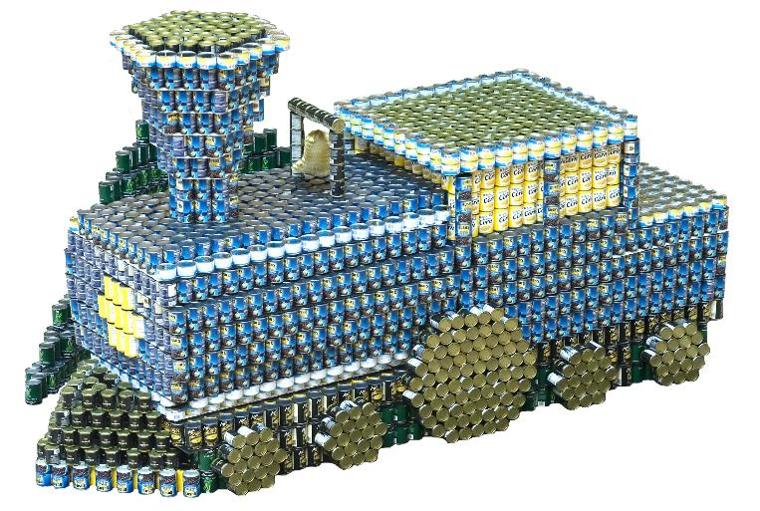
Mission Statement
Notes:
Through the structure you build, the emotional connection people associate with it visually, the power of the message in your statement and the content of your food can be powerful.

Slide 10
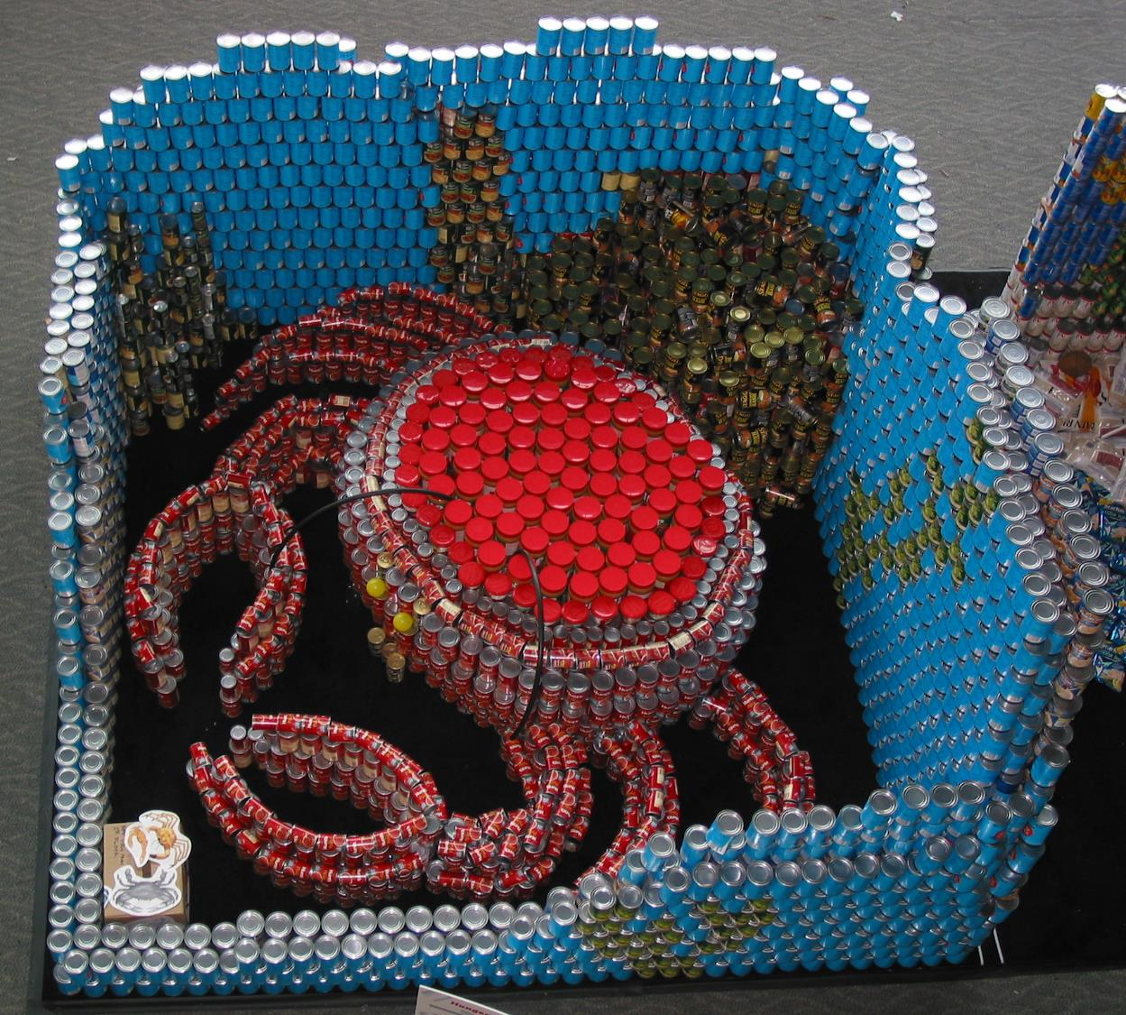
Notes:
Hunger makes me Crabby
Fill your space

Slide 11
The Awards Catergories
Best Original Design
Best Meal
Best Use of Labels
Structural Ingenuity
Most Cans
People’s Choice

Slide 12
Go for the Gold!......if that is your goal
If you want to win an award specifically, by all means have amazingly colorful labels or crazy structural elements. But over the years, most teams that win the awards are the ones that are strong in each category and have great food. You can have the cutest structure but if it’s made entirely of Top Ramen and Beef Broth, the jury most likely won’t award your structure.

Slide 13
Go for the Gold!......tips
Use CANS! It’s not BoxStruction or BagStruction
WHAT is IT? If the public can’t tell what it is, that’s a problem.
Make it intriguing; small details that are only noticed upon examination are great. Props are okay as long as they are well thought out, not lazy.
Tie the Mission Statement to the Visual.

Slide 14
Mentorship
Are you having a structural issue?
Having a hard time with Mission Statement?
Are you stuck?
Check our website for guidance – www.canstructionPDX.org
We’ve been at this for 25 years, so ask for guidance!
Contact Christopher Mount at info@canstructionPDX.org

Slide 15
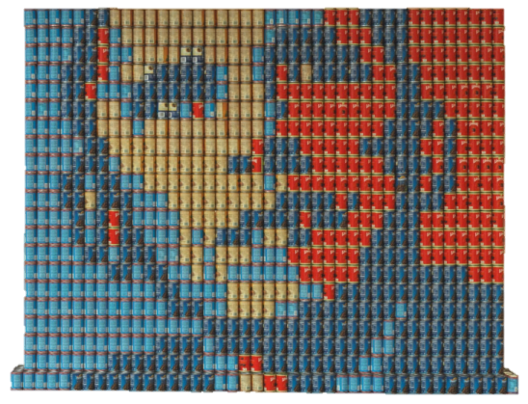
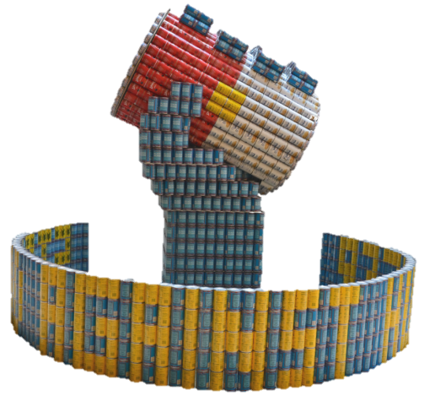
Success!
Get Options
Pricing of cans, for all major elements; get three options
For can colors; get options
For sizing…..Options!
Designers vs. Shoppers vs. Fundraisers = you need a diverse group!
Ask for a Mentor

Slide 16
Budget & Fundraising
PORTLAND
How do you pay for your canstructure?

Slide 17
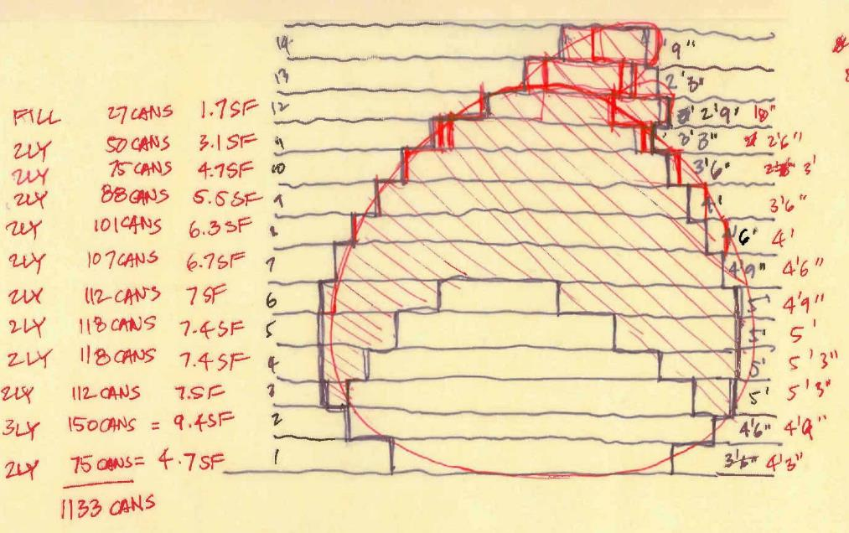
Establishing a Budget
Determine the size and scale of your structure

Slide 18
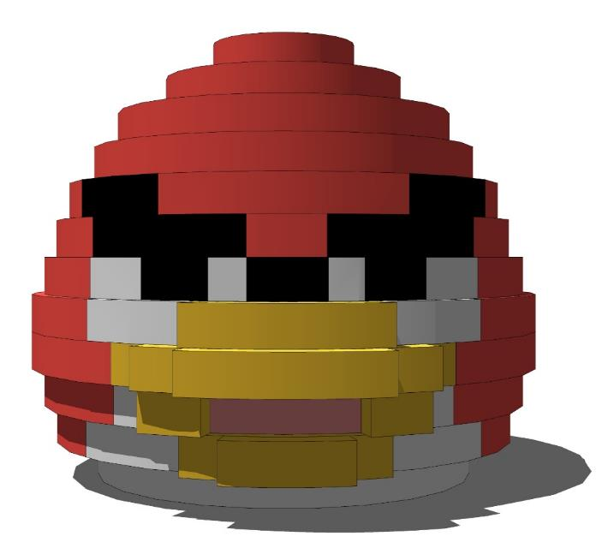
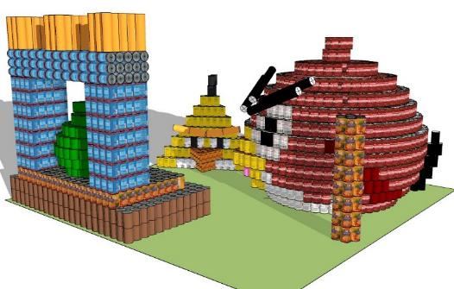
Establishing a Budget
Create a simple model to determine color and quantity of face cans needed

Slide 19
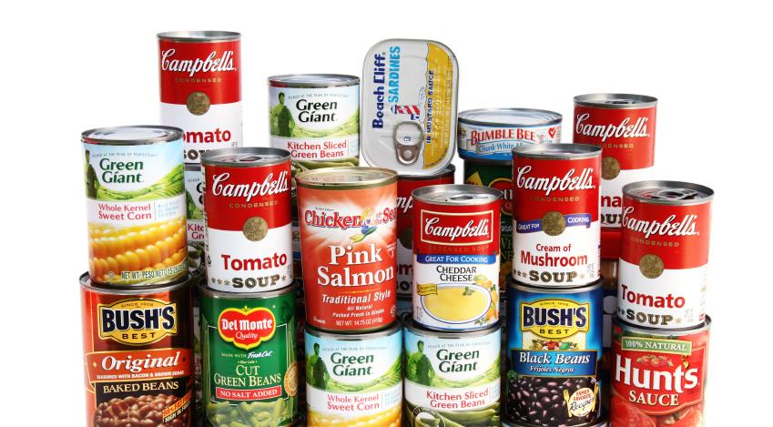
Establishing a Budget
Pick out cans from the grocery store that match the colors needed in your structure and determine cost
Tip: Find filler cans that match the size of your face cans that are cheaper to save cost

Slide 20
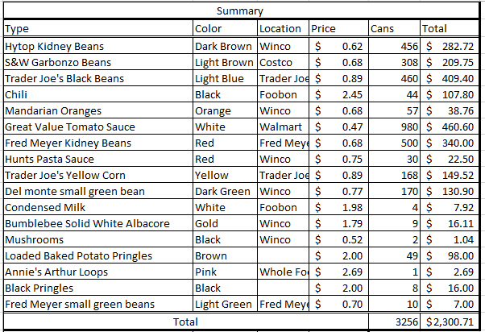
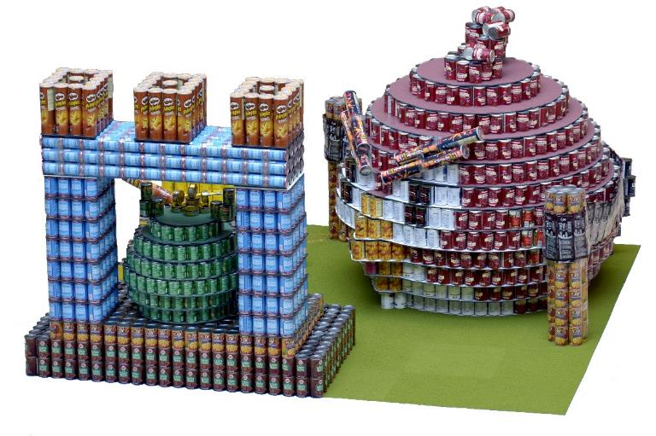
Establishing a Budget
Angry Birds Structure was 3,256 cans totaling $2,300 in 2011

Slide 21
Establishing a Budget
An average structure cost can vary from approximately $3,000 - $6,000
Include your “props,” leveling, etc. in your budget
Buy extra cans (for those Design Build moments)

Slide 22
Fundraising from Top Down
Does your firm support Team Building and Community Involvement? Here is an easy way for them to do both!
Ask your firm to fund your structure 100%!
Ask your firm to support your employee volunteers 100%!

Slide 23
Fundraising Suggestions
Partner with another firm to cut expenses in half
Create your own online donation link

Slide 24
Fundraising Suggestions
Ask clients, consultants and vendors to join your efforts in raising the funds to build your structure
Team competition events
Sponsor Thanks section on Structure Board

Slide 25
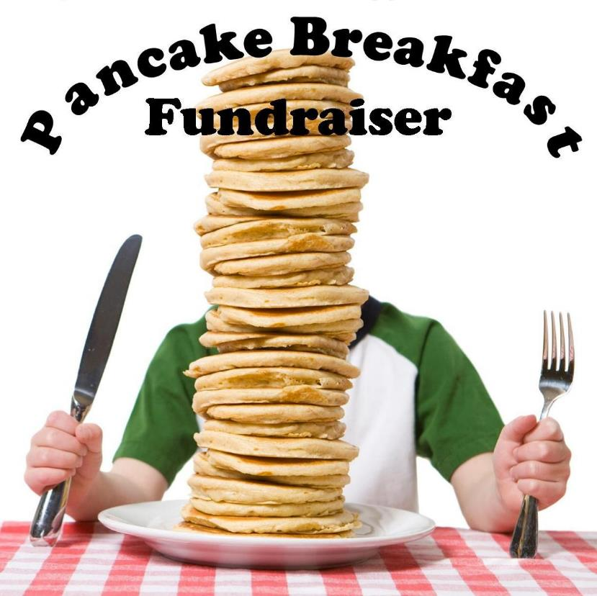
Fundraising begins with FUN!

Slide 26
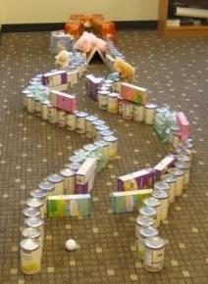
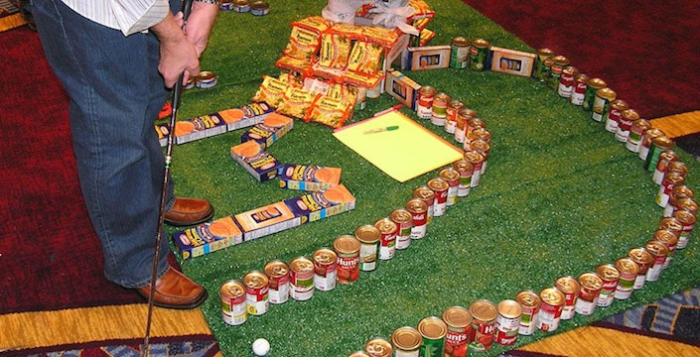
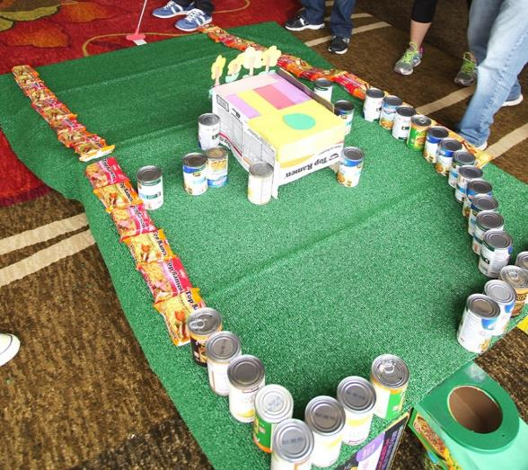
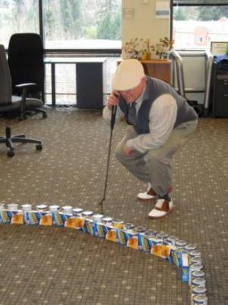
Fundraising begins with FUN!

Slide 27
Fundraising begins with FUN!
Look on-line for ideas!
Be creative and silly
Customize your idea to our industry and to your firm culture
Know your audience
Challenge the Boss!

Slide 28
FAQs
Oregon Food Bank is a 501c3
At the end of the event, OFB will send out a receipt for the pounds of food for your structure which can be used for your tax records.

Slide 29
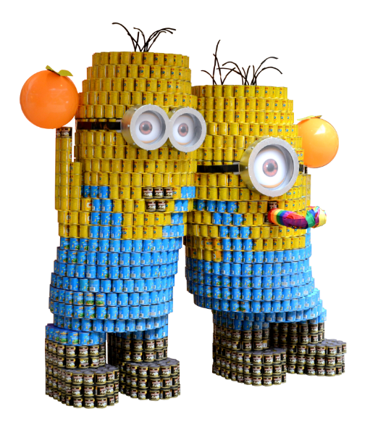
Event Rules
PORTLAND

Slide 30
Food Allowed
Aluminum cans of all sizes
Full, unopened, cans with labels intact and legible
Plastic containers (non-weight bearing)
Boxes and bags of food (although not encouraged)
All teams are responsible for obtaining their own supply of canned foods.

Slide 31
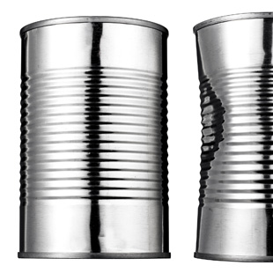
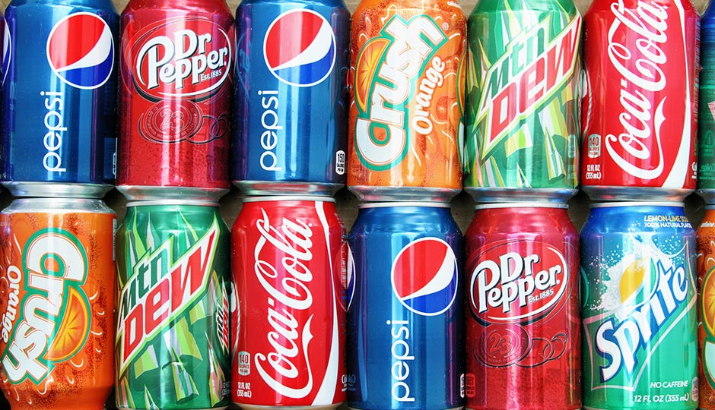
Food Not Allowed
Glass containers
Plastic containers (weight bearing)
Food items with their labels covered, stripped off, or altered
Empty containers
Open or exposed food items
Pet food
Alcoholic beverages
Soda or junk food
Perishable or homemade items

Slide 32
Approved Leveling Materials
¼ inch and thinner cardboard, foam-core, masonite, MDF, plywood, and plexiglass.
¼ inch and thinner cardboard tubes, wooden and threaded rods used for alignment.
Velcro, magnets
Clear single and double-faced tape
High-tension rubber bands, nylon string, wire, tie-backs, zip ties
Your canstruction must be structurally self-supporting in order to be eligible for an award.

Slide 33
Not-approved Build Items
2 x 4 boards
Half-inch or thicker plywood
Half-inch or thicker tubing
Sheet metal
Permanent adhesive
Hot glue
No power tools
Exception: Some items on the not-approved list may be used as part of your form-work to build your structure. All of the not-approved items must be removed prior to the completion of your structure

Slide 34
Props
Accessory props are allowed but discouraged. Props should not be a dominating feature of the entry.
Jurors tend to favor structures without props.

Slide 35
Build-Out Regulations
Maximum size for structure is 10ft x 10ft x 8ft tall.
Five members of the team are allowed on the carpet at one time; other team members are allowed to assist on site.
You are allowed approximately 6 hours of build time to complete your structure.
Bring all supplies you will need to build your structures.
Leave your area “broom clean”
Take all trash with you and dispose off-site

Slide 36
Remember…
Easily identifiable
All cans
Colorful
Simplistic
Photogenic
Powerful Mission Statement
And…No Power Tools!

Slide 37
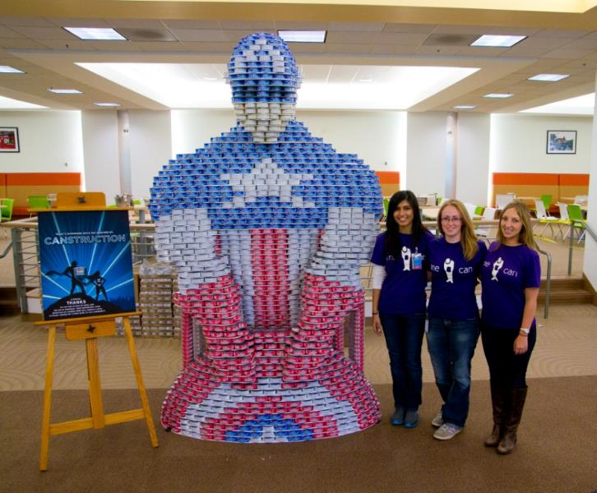
Logistics
PORTLAND

Slide 38
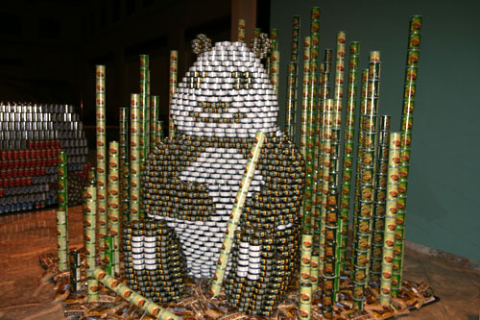
Logistics Outline
Teaming & Partnering
Submittals
Pre-build
Transport Food
Build-out
Schedule
Gala and Awards Ceremony
DeCanstruction

Slide 39
Teaming & Partnering
Participating members
Clients/Consultants
Build relationships
Regular meetings

Slide 40
Submissions Schedule
Deadline for Entry: Friday, May 24, 2024 (Entry fee and form is due to secure your spot in the event)
Submittal No. 1: Friday, June 21, 2024 (Include: 1. Name of each participating company, 2. Structure Idea: Just send text description to ensure there are no duplicate structures—1st come 1st served, 3. Firm “handles”, 4. Firm Logos)
Submittal No. 2: Friday, July 19, 2024 (Include: 1. Structure Title, 2. Sketch of structure, 3. Structure Dimensions, 4. Mission Statement, 5. Structure requests, 6. Firm names for 2024 T-Shirt)
Submittal No. 3: Friday, August 23, 2024 (Include: 1. Grocery List: type of can food, 2. Total Can Count, 3. Sponsor info for “Special Thanks” section, 4. Address of food pickup location, 5. Names and e-mail of all team members, 6. T-Shirt sizes/order extra, 7. Misc. other)

Slide 41
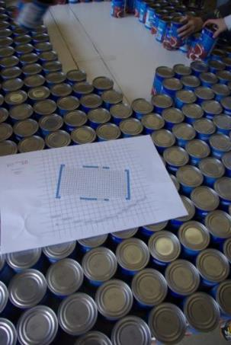
Pre-build
Test the Design
Confirm your supply
change of label, enough at one store…
Prepare building materials
pre-cut leveling devices (foam core, plexiglass, cardboard…)
Minimum partial pre-build
Complete 3-4 weeks before build-out

Slide 42
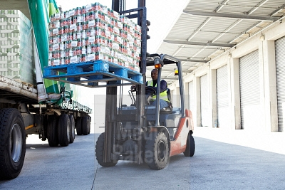
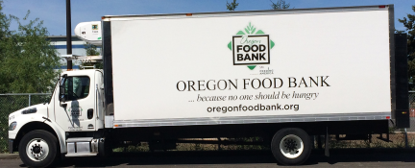
Transport Food
Pre-build first
Repack food on pallet no higher than 4 feet high for pickup
Don’t miss OFB transport
From only ONE location (grocery store, your office…)
Plan for two-three weeks before build-out

Slide 43
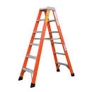
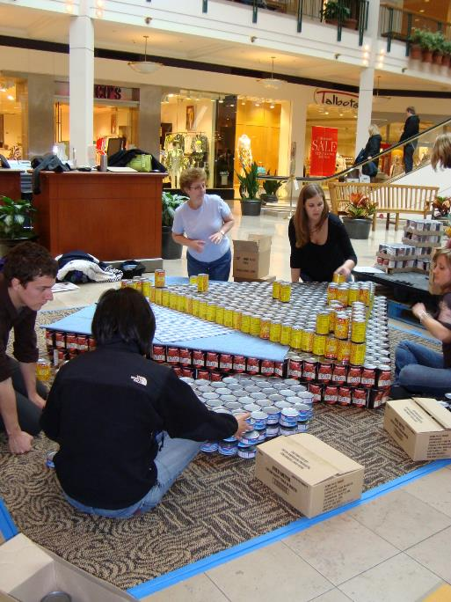
Build-Out
Five team members
Supplies
leveling devices
ladder
clear tape (leave on can)
box cutter
Take out what you brought in
Eat in designated eating areas
No power tools

Slide 44
Build-Out Week Schedule (Mid-Sept)
Build Out: Monday
Judging: Tuesday (afternoon)
Awards Gala: Tuesday (evening)
Public Viewing: Monday - Sunday
De-canstruction: Sunday

Slide 45
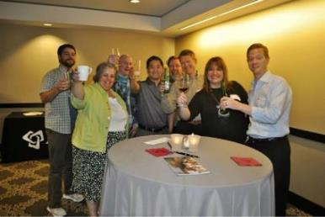
Gala and Awards Ceremony
Jury members will tour the structures and deliberate then announce the winners
Teams, sponsors, and volunteers are recognized at the Gala and Awards Ceremony

Slide 46
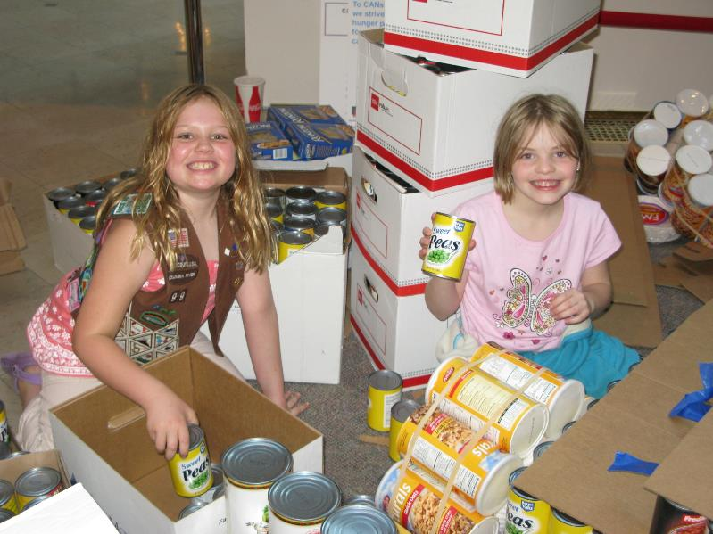
DeCanstruction
Team members
family affair
Lots of help
OFB Volunteers
Girl Scouts?
Super fast

Slide 47
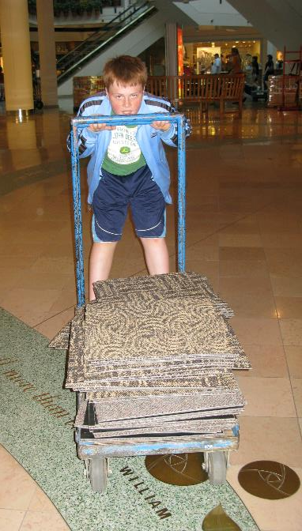
De-canstruction
Each team must bring at least 5 volunteers
OFB bins and original boxes will be available for you to reload your food
All items that teams brought into Pioneer Place must be removed
Teams are responsible for leaving their site “broom-clean”

Slide 48
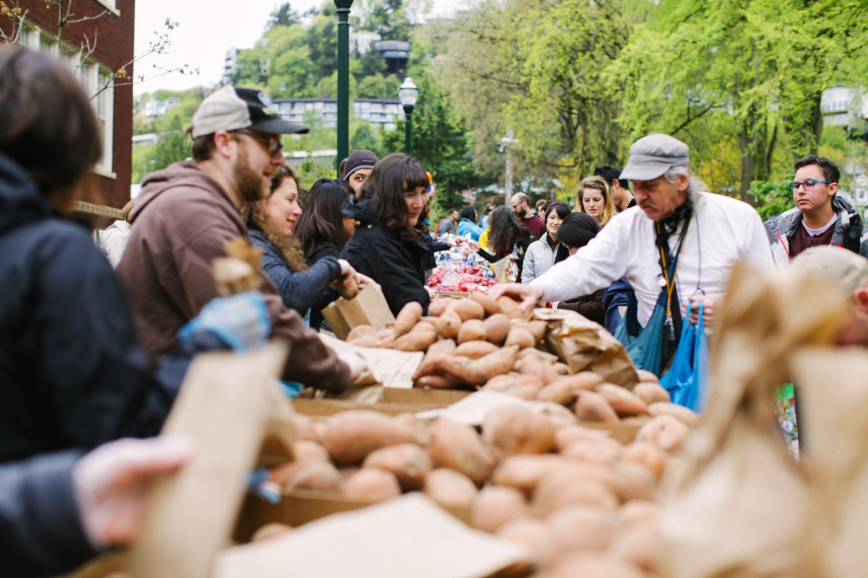
What CANstruction
means to our community

Slide 49
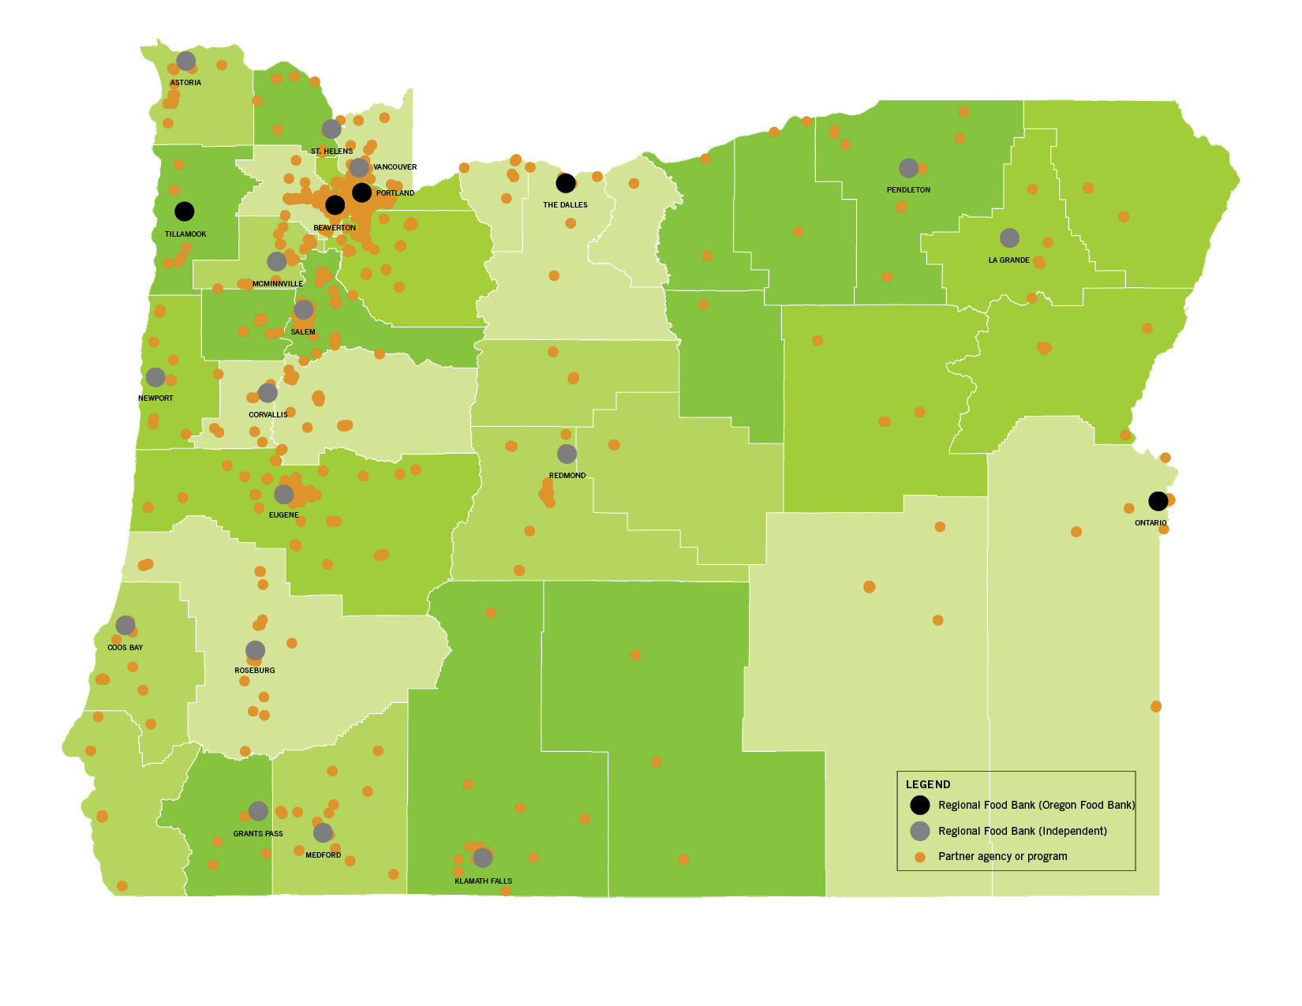
About Oregon Food Bank
The Oregon Food Bank Network is made up of 21 regional food banks partnering with more than 1,400 free food markets, pantries, meal sites and delivery programs.
Our strength is this Network, which sourced and distributed over 104 million pounds last year — emphasizing fresh produce, dairy, protein and pantry staples.
Many locations are shopping-style markets that allow
families to select food that matches cultural and
dietary needs.

Slide 50
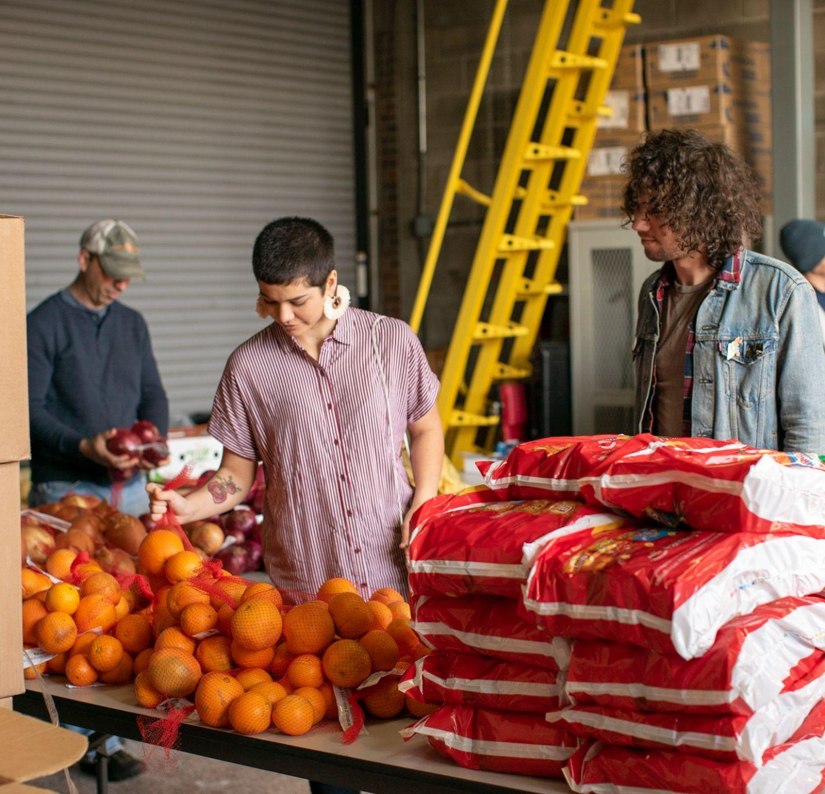
The state of hunger
Today, nearly 1 in 10 people in our communities face hunger.
The rising cost of food and housing is worsening food insecurity in Oregon, Southwest Washington and across the country.
Last year, we saw 1.9 million visits to food assistance sites through the Oregon Food Bank Network — a 14% increase from the previous year. And the public health and economic impacts of the pandemic have fallen hardest on people who have faced
systemic inequities for generations: people of color;
immigrants and refugees; single parents and caregivers;
and trans and gender non-conforming neighbors

Slide 51
The effects on us
Hunger does not occur in isolation, and has detrimental effects on our bodies, our minds, and our overall community. Those experiencing hunger develop micronutrient (vitamins/minerals) deficiencies; are more likely to develop chronic diseases such as high blood pressure and diabetes leading to increased health costs (people who lack consistent access to adequate food spend roughly 45 percent more on medical care); as well as worse educational and work outcomes; and social isolation and depression. These are all exacerbated when experienced by children.
Food insecurity can have profound and lasting effects on the physical, cognitive and socio-emotional development of children, especially during early childhood. Keeping children nourished during this period of development is one of the most impactful ways we can build a strong foundation for the future.

Slide 52
What Oregon Food Bank and you are doing about it:
FOOD FOR TODAY
We build community connections
to help people access nutritious, culturally relevant food when and where they need it.
53% of all food distributed is fresh or frozen produce, dairy and protein. And in 2023 720,600+ community members accessed resources via OFB’s recourse site, OregonFoodFinder, across 14 languages
FOOD FOR TOMORROW
We build community power to eliminate the root causes
of hunger for good.
OFB invests in growers & BIPOC farmers, native fishers, local community partners, cultivates healthcare and education collaborations, and advocate for policy change to address hunger and its root causes. Last year, more than 3,000 people
took action to advance anti-hunger policy..
CANstruction is how YOU provide food to our neighbors raise and public awareness of hunger!

Slide 53
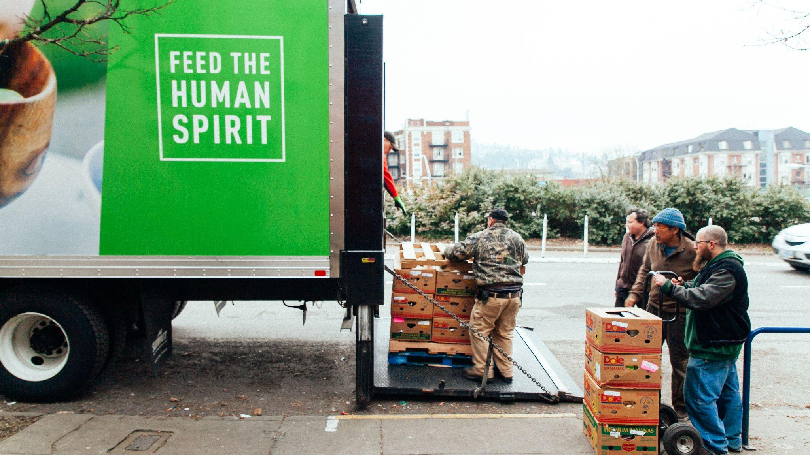
The Time is Now
Your support ensures that our local food systems are strong and resilient; and it will help us dismantle the systems that drive poverty in our communities.
Hunger is an ongoing crisis.
And with your ongoing love and support,
we can end it for good.

Slide 54
Questions? Want to learn more about our work?
E-mail MGray@OregonFoodBank.org
or visit OregonFoodBank.org
Notes:
Join us, won’t you?
Questions?

